Slide 1
CSC2210 OPERATING SYSTEMS I
Memory management techniques
Lecture Three

Slide 2
Memory Allocation Schemes
Memory management evolve with four new memory allocation schemes.
Paged Memory Allocation (PMA)
Demand Paging Memory Allocation (DPMA)
Segmented Memory Allocation (SMA)
Segmented/Demand Paging Memory Allocation (S/DPMA)
Theses memory allocation schemes remove the restriction of storing the programs contiguously, and most of them eliminate the requirement that the entire program reside in memory during its execution.

Slide 3
Paged Memory Allocation (PMA)

Slide 4
Paged Memory Allocation
Paged memory allocation is based on the concept of dividing jobs into units of equal size and each unit is called a page. Some operating systems choose a page size that is the exact same size as a section of main memory, which is called a page frame. Likewise, the sections of a magnetic disk are called sectors or blocks.
The paged memory allocation scheme works quite efficiently when the pages, sectors, and page frames are all the same size.

Slide 5
Jobs Ready for Execution
Before executing a program, a basic Memory Manager prepares it by:
Determining the number of pages in the program
Locating enough empty page frames in main memory
Loading all of the program’s pages into those frames
When the program is initially prepared for loading, its pages are in logical sequence — the first pages contain the first instructions of the program and the last page has the last instructions. These jobs can be loaded in noncontiguous page frames. In fact, each page can be stored in any available page frame anywhere in main memory

Slide 6
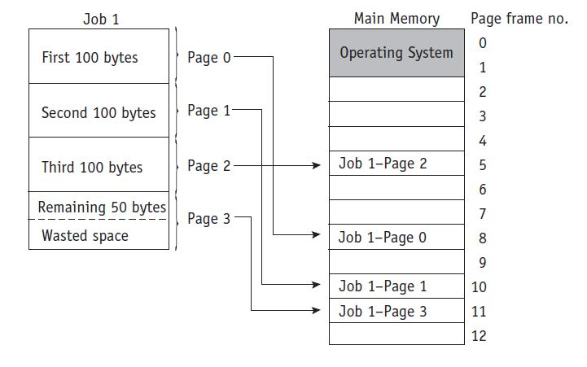
Example of PMA Scheme

Slide 7
Table of PMA
Memory Manager uses some three tables;
Job Table,
Page Map Table, and
Memory Map Table
to keep track of the pages as they are fit into page frames

Slide 8
The Job Table
The Job Table (JT) contains two values for each active job: the size of the job (shown on the left) in the figure below and the memory location where its Page Map Table is stored (on the right)
The Job Table is a dynamic list that grows as jobs are loaded into the system and shrinks, as shown in (b) in the figure below, as they are later completed.

Slide 9
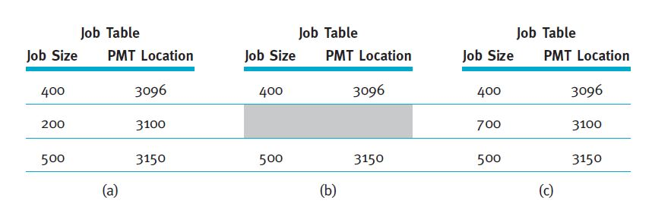
Sample of the Job Table

Slide 10
Page Map Table (PMT)
Each active job has its own Page Map Table (PMT), which contains the vital information for the page—the page number and its corresponding memory address of the page frame.

Slide 11
Memory Map Table (MMT)
A simple Memory Map Table (MMT) has one entry for each page frame and shows its location and its free/busy status.

Slide 12
Advantages of PMA
A huge advantage of a paging scheme is that:
It allows jobs to be allocated in noncontiguous memory locations.
It allows memory to be used more efficiently.

Slide 13
Disadvantage of PMA
overhead is increased, and
internal fragmentation is still a problem, although it occurs only in the last page of each job.
it still requires that the entire job be stored in memory during its execution

Slide 14
Demand Paging Memory Allocation (DPMA)

Slide 15
Demand Paging Memory Allocation
Demand paging introduced the concept of loading only a part of the program into memory for processing.
It was the first widely used scheme that removed the restriction of having the entire job in memory from the beginning to the end of its processing.

Slide 16
Concept of DPMA
The concept of demand paging is that jobs are still divided into equally-sized pages that initially reside in secondary storage.
When the job begins to run, its pages are brought into memory only as they are needed, and if they’re never needed, they’re never loaded.
It takes advantage of the fact that programs are written sequentially so that while one section, or module, is processed, other modules may be idle. Not all the pages are accessed at the same time, or even sequentially.

Slide 17
Scenarios of DPMA
Instructions to handle errors are processed only when a specific error is detected during execution. For instance, these instructions can indicate that input data was incorrect or that a computation resulted in an invalid answer. If no error occurs, and we hope this is generally the case, these instructions are never processed and never need to be loaded into memory.

Slide 18
Scenarios of DPMA contd.
Many program modules are mutually exclusive. For example, while the program is being loaded (when the input module is active), then the processing module is inactive because it is generally not performing calculations during the input stage. Similarly, if the processing module is active, then the output module (such as printing) may be idle.

Slide 19
Scenarios of DPMA contd.
Certain program options are either mutually exclusive or not always accessible. For example, when a program gives the user several menu choices, it allows the user to make only one selection at a time. If the user selects the first option, then the module with those program instructions is the only one that is being used, so that is the only module that needs to be in memory at this time

Slide 20
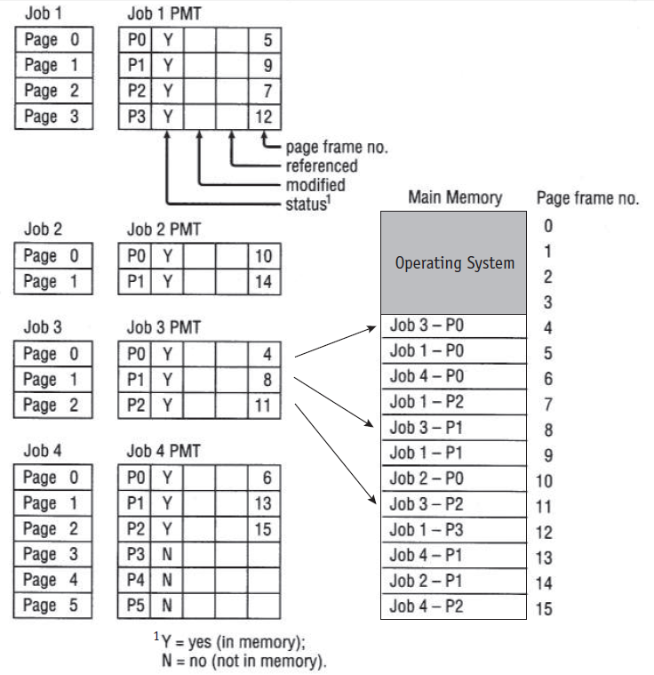
DPMA Example

Slide 21
Demand paging requires that the Page Map Table for each job keep track of each page as it is loaded or removed from main memory. Each PMT tracks the status of the page, whether it has been modified, whether it has been recently referenced, and the page frame number for each page currently in main memory

Slide 22
Advantages of DPMA
The demand paging scheme allows the user to run jobs with less main memory than is required if the operating system is using the paged memory allocation scheme.
Demand paging scheme can give the appearance of vast amounts of physical memory when, in reality, physical memory is significantly less than vast.

Slide 23
Disadvantages of DPMA
When there is an excessive amount of page swapping between main memory and secondary storage, the operation becomes inefficient. This phenomenon is called thrashing.
Thrashing is similar to the problem that students face when comparing explanations of a complex problem in two different textbooks. The amount of time you spend switching back and forth between the two books could cause you to spend more time figuring out where you left off in each book than you spend actually solving the issue at hand.

Slide 24
Segmented Memory Allocation (SMA)

Slide 25
Segmented Memory Allocation (SMA)
The concept of segmentation is based on the common practice by programmers of structuring their programs in modules—logical groupings of code.
With segmented memory allocation, each job is divided into several segments of different sizes, one for each module that contains pieces that perform related functions

Slide 26
SMA contd.
This is fundamentally different from a paging scheme, which divides the job into several pages all of the same size, each of which often contains pieces from more than one program module.
In this memory allocation scheme also, the main memory is no longer divided into page frames, because the size of each segment is different ranging from quite small to large.

Slide 27
How the SMA Works
When a program is compiled or assembled, the segments are set up according to the program’s structural modules. Each segment is numbered and a Segment Map Table (SMT) is generated for each job; it contains the segment numbers, their lengths, access rights, status, and (when each is loaded into memory) its location in memory.

Slide 28
SMA Example

Slide 29
SMA Example contd.
The figure below shows a job, Job 1 that’s composed of a main program and two subroutines (for example, one subroutine calculates the normal pay rate, and a second one calculates the overtime pay or commissions)
It is a single job that is structurally divided into three segments of different sizes.

Slide 30
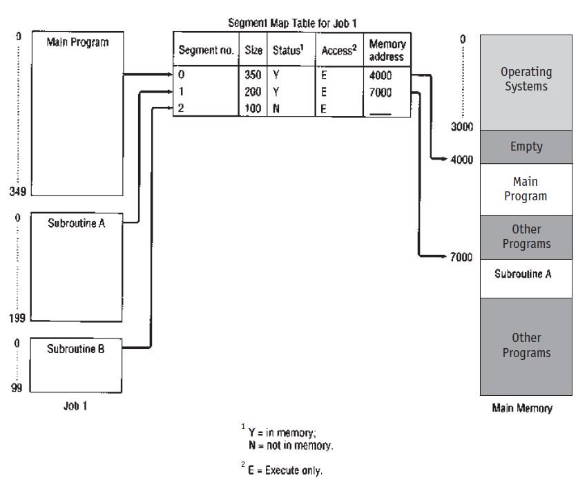

Slide 31
The Memory Manager needs to keep track of the segments in memory. This is done with three tables, combining aspects of both dynamic partitions and demand paging memory management:
• The Job Table lists every job being processed (one for the whole system).
• The Segment Map Table lists details about each segment (one for each job).
• The Memory Map Table monitors the allocation of main memory (one for the
whole system).

Slide 32
Disadvantage of SMA
The disadvantage of any allocation scheme in which memory is partitioned dynamically is the return of external fragmentation. Therefore, recompaction of available memory is necessary from time to time.

Slide 33
Segmented/Demand Paging Memory Allocation (S/DPMA)

Slide 34
Segmented/Demand Paged Memory Allocation
The segmented/demand paged memory allocation scheme evolved from a combination of segmentation and demand paging, and it offers the logical benefits of segmentation, as well as the physical benefits of paging.

Slide 35
S/DPMA Contd.
This allocation scheme doesn’t keep each segment as a single contiguous unit, but subdivides it into pages of equal size that are smaller than most segments and more easily manipulated than whole segments. Therefore, many of the problems of segmentation (compaction, external fragmentation, and secondary storage handling) are removed because the pages are of fixed length.

Slide 36
S/DPMA Tables
This scheme, requires four types of tables as in the figure below:
The Job Table lists every job in process (there’s one JT for the whole system).
The Segment Map Table lists details about each segment (one SMT for each job).
The Page Map Table lists details about every page (one PMT for each segment).
The Memory Map Table monitors the allocation of the page frames in main memory (there’s one for the whole system).

Slide 37
S/DPMA - Example

Slide 38
Disadvantages of S/DPMA
The major disadvantages of this memory allocation scheme are twofold:
The overhead that is required to manage the tables (Segment Map Tables and the Page Map Tables), and
The time required to reference them.

